Slide 1
Data Science
Saurabh Jain

Slide 2
About Me
Who: Saurabh Jain
Where: Persistent Systems
What: Data Scientist, Enterprise Applications
How: MS in Data Science, Indiana University
BTech in CS, Visvesvaraya National Institute of Technology
When: Since 12+ years

Slide 3
Aim
Entice you into Data Science as a career

Slide 4
Flow
Why to discuss Data Science?
What is Data Science?
The Fourth Paradigm
Four V’s of Data
Data Science Umbrella, Technologies, Lifecycle
How Machines Learn, AI, ML, DL?
Machine Learning – Intro
Applications of Data Science, ML
Learnings from Industry
Learn Data Science

Slide 5
What Big Guns are talking about Data Science
Data Scientist: The Sexiest Job of the 21st Century – HBR 2012
https://hbr.org/2012/10/data-scientist-the-sexiest-job-of-the-21st-century
Second Fastest growing Profession – LinkedIn 2017
https://blog.linkedin.com/2017/december/7/the-fastest-growing-jobs-in-the-u-s-based-on-linkedin-data
Which is at Top ☺?
50 percent gap in the supply – Mckinsey, Amazon
https://blog.alexa.com/know-data-science-important/

Slide 6
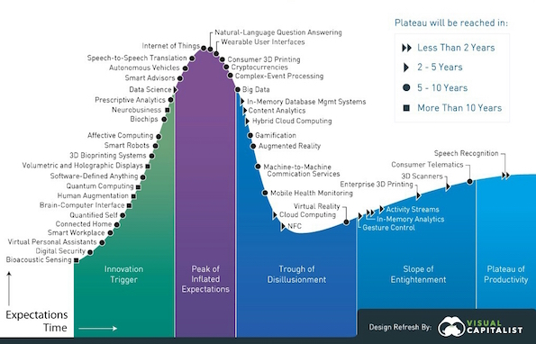
Why Data Science? – Gartner Hype Cycle – 2017

Slide 7
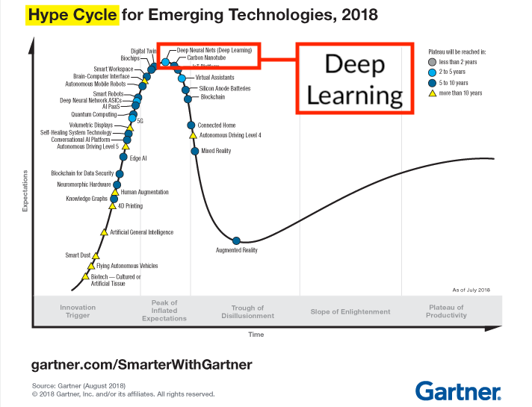
Why Data Science? – Gartner Hype Cycle – 2018

Slide 8
What is Data Science?
Poll
https://pollev.com/saurabhjain220

Slide 9
Data Science – Definition
Applying advanced statistical tools to existing data to generate new insights.
Data science is a multidisciplinary blend of data inference, algorithm development, and technology in order to solve analytically complex problems.
Wikipedia – Data science is an interdisciplinary field that uses scientific methods, processes, algorithms and systems to extract knowledge and insights from data in various forms, both structured and unstructured, [1][2] similar to data mining.
Bookish???

Slide 10
DIKW
Datum (singular of data) (an observation): 12
Information (data in context): 12 degrees Fahrenheit
Knowledge (information in context): 12 degrees Fahrenheit, today, at 7:30 AM, in Summerville, Oregon
Wisdom (application of knowledge in context): I need to put on a coat when I go out
Data
Information
Knowledge
Wisdom

Slide 11
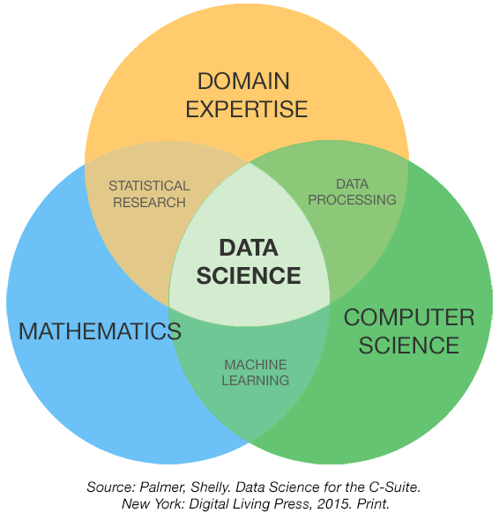
Data Science – Intersection of Fields

Slide 12
Data Science – Intersection of Fields
DOMAIN EXPERTISE
STATISTICAL RESEARCH
DATA PROCESSING
DATA SCIENCE
MATHEMATICS
COMPUTER SCIENCE
MACHINE LEARNING
Source: Palmer, Shelly, Data Science for the C-Suite. New York: Digital living Press, 2015. Print

Slide 13
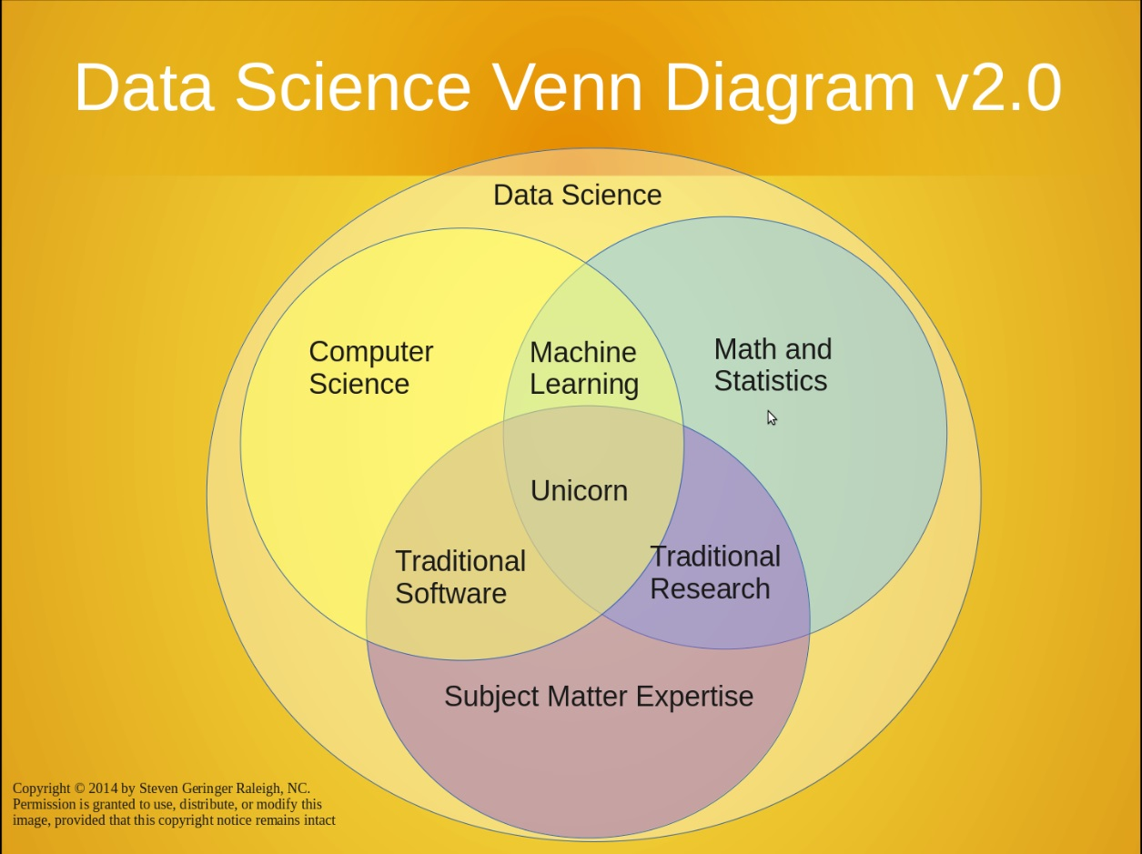
Data Science – Superset of Fields

Slide 14
Data Science – Superset of Fields
Data Science Venn Diagram v2.0
Data Science
Computer Science
Machine Learning
Math and Statistics
Unicorn
Traditional Software
Traditional Research
Subject Matter Expertise
Copyright © 2014 by Steven Geringer Raleigh, NC. Permission is granted to use, distribute, or modify this image, provided that this copyright notice remains intact

Slide 15
The Fourth Paradigm
Thousand Years Ago – Empirical, Experimental
Describing natural phenomenon, Fire
Last Few hundred years – Theoretical
Newtons Laws, Generalizations
Last Few Decades – Computational Science
Simulation of complex Phenomena, Predict Global warning?
Today – Data Science
Science based, data intensive computing
Scientists overwhelmed with vast datasets
From instruments, IoT
From simulations
From networks
From Users i.e. Google, Facebook

Slide 16
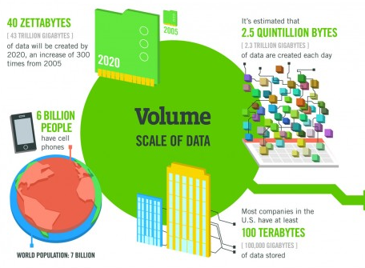
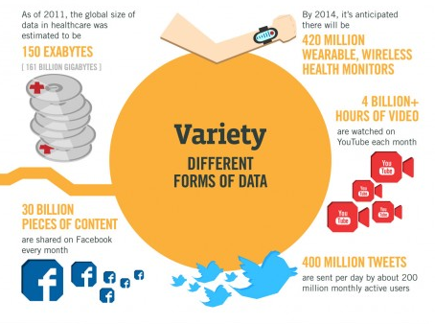
Explosion of Data – Data is New Oil
Source: https://www.ibmbigdatahub.com/infographic/four-vs-big-data

Slide 17
Four V’s of Data
Volume
Scale of Data
Variety
Different forms of Data
Velocity
Streaming Data, Data Flow
Veracity
Uncertainty, Quality of Data

Slide 18
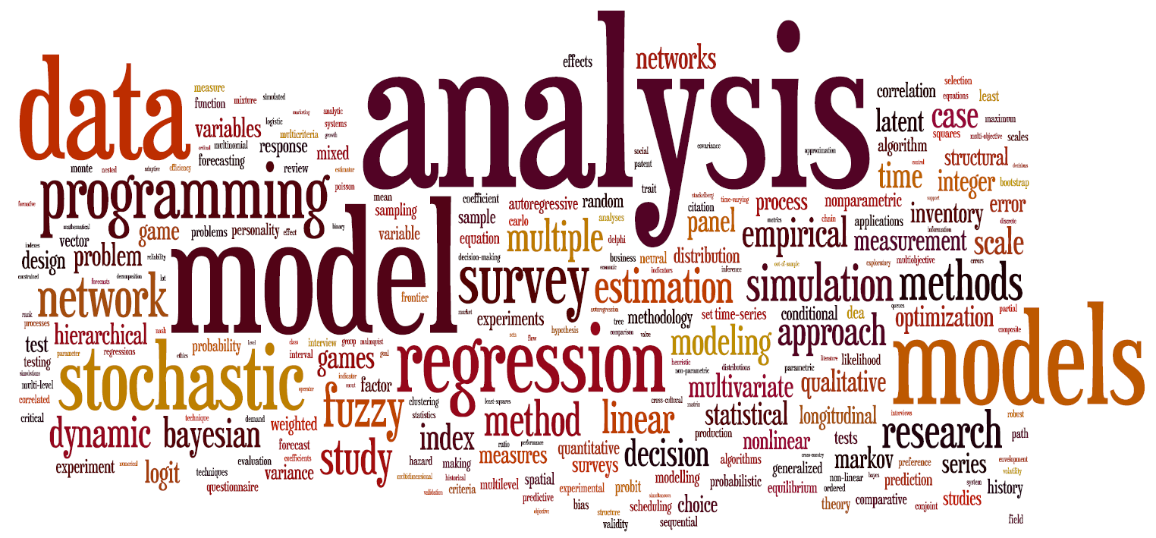
Word Cloud for Data Science Applying advanced statistical tools to existing data to generate new insights

Slide 19
Data Science Umbrella
Data Analytics
Big Data
Machine Learning
Artificial Intelligence
Statistics
Network Theory
Visualization
Cloud
Data Engineering
Predictive Analytics
Stream Analytics
Deep Learning
Information Engineering
Data Warehouse
Data Mining
Data Wrangling
Mathematics
IoT
Business Analytics
NoSQL Database
Data Virtualization
Distributed Storage
Knowledge Discovery Tools
Computer Science

Slide 20
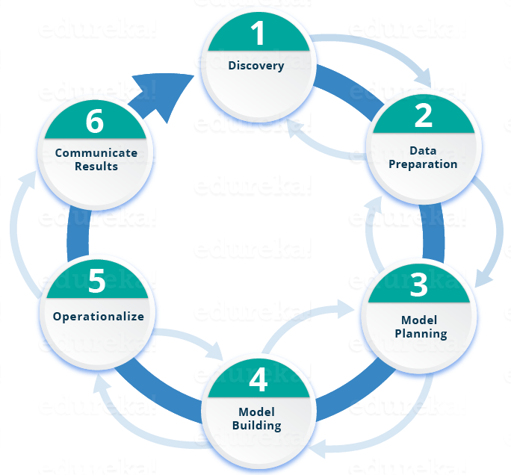
Lifecycle
Source: https://www.edureka.co/blog/what-is-data-science/

Slide 21

Lifecycle
Discovery
1
Communicate Results
Data Preparation
6
2
Operationalize
Model Planning
5
3
Model Building
4
Source: https://www.edureka.co/blog/what-is-data-science/

Slide 22
What is the need for Machines to do Data Interpretation?
Massive amount of data to process
Computers don’t fight
Computers don’t have prejudice
Computers don’t have bias
No meetings

Slide 23
How do Humans Learn?
Consider a child
Scenario
Frequent high volume tasks –
Grading an essay
Sorting mails
Spam vs Non-spam
Predicting weather

Slide 24
How do Machines Learn?
Artificial Intelligence
Machine Learning
Deep Learning
Requirement – Large volume of past data

Slide 25

AI vs ML vs DL
Artificial Intelligence
Machine Learning
Deep Learning – A Technique for Implementing Machine Learning
Human Intelligence Exhibited by Machines
A technique which enables machines to mimic human behavior
An Approach to Achieve Artificial Intelligence
Programs that alter themselves
Subset of AI technique which use statistical methods to enable machines to improve with experience
Subset of ML which make the computation of multi-layer neural network feasible

Slide 26
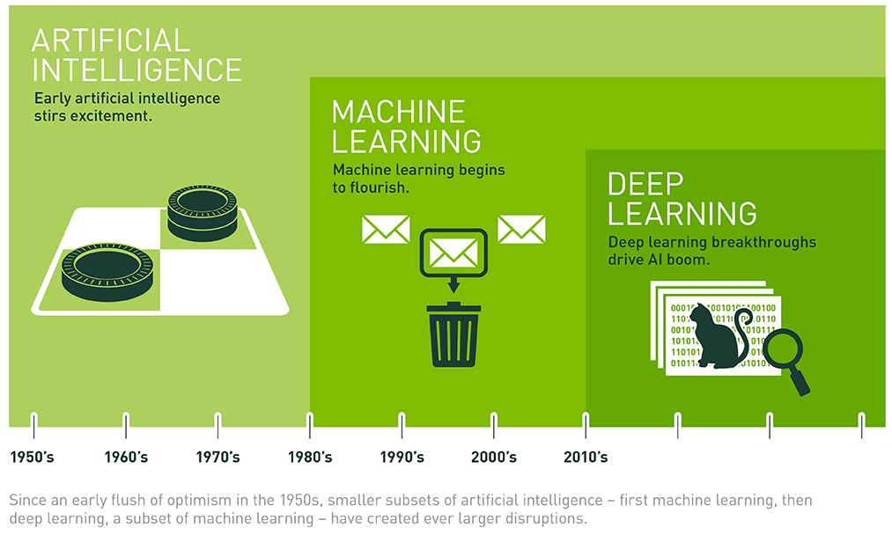
AI vs ML vs DL
Source: https://blogs.nvidia.com/blog/2016/07/29/whats-difference-artificial-intelligence-machine-learning-deep-learning-ai/

Slide 27
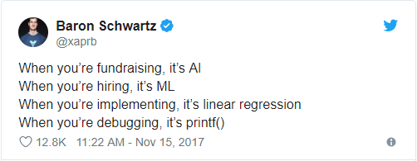
AI vs ML vs DL
Source: https://blogs.nvidia.com/blog/2016/07/29/whats-difference-artificial-intelligence-machine-learning-deep-learning-ai/

Slide 28
Machine Learning Types
Supervised Learning
The outcome or output for the given input is known before itself
Unsupervised Learning
The outcome or output for the given inputs is unknown
Reinforcement Learning
The machine is exposed to an environment where it gets trained by trial and error method

Slide 29
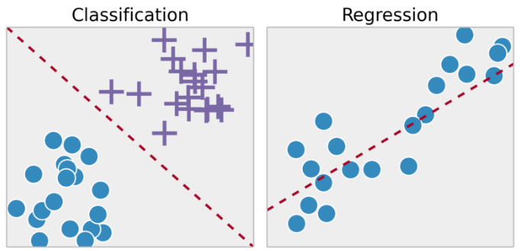
Machine Learning Types
Supervised Learning
Regression and classification problems are mainly solved here
Labelled data is used for training here
Popular Algorithms: Linear Regression, Support Vector Machines (SVM), Neural Networks, Decision Trees, Naive Bayes, Nearest Neighbor

Slide 30
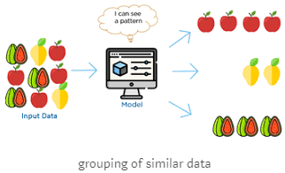
Machine Learning Types
Unsupervised Learning
Clustering problems (grouping), Anomaly Detection (in banks for unusual transactions) where there is a need for finding relationships among the data given
Unlabeled data is used in unsupervised learning
Popular Algorithms: k-means clustering, Association rule

Slide 31
Machine Learning Types
Semi-supervised Learning
In-between that of Supervised and Unsupervised Learning
Labelled and unlabeled data

Slide 32
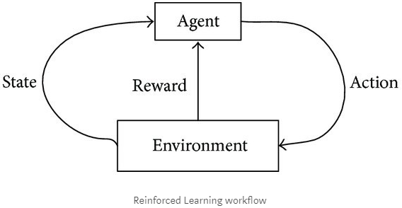
Machine Learning Types
Reinforced Learning
Machine learns from past experience and tries to capture the best possible knowledge to make accurate decisions based on the feedback received
Source: https://towardsdatascience.com/machine-learning-types-and-algorithms-d8b79545a6ec

Slide 33
Machine Learning Types
Reinforced Learning
Machine learns from past experience and tries to capture the best possible knowledge to make accurate decisions based on the feedback received
Agent
State
Reward
Action
Environment
Reinforced Learning Workflow
Source: https://towardsdatascience.com/machine-learning-types-and-algorithms-d8b79545a6ec

Slide 34
Machine Learning Common Algorithms
Linear Regression
Logistic Regression
Decision Tree
SVM
Naive Bayes
kNN
K-Means
Random Forest
Dimensionality Reduction Algorithms
Gradient Boosting Algorithms

Slide 35
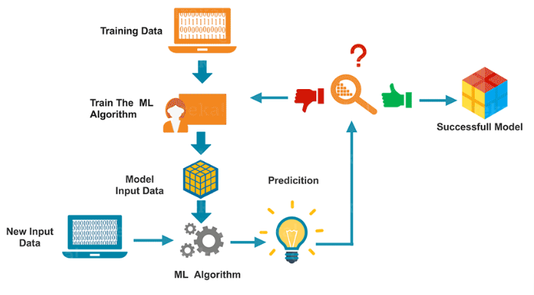
Machine Learning Flow
Source: https://www.edureka.co/blog/what-is-machine-learning/

Slide 36
Machine Learning Flow
Training Data
Train The ML Algorithm
Successfully Model
Model Input Data
New Input Data
ML Algorithm
Prediction
Source: https://www.edureka.co/blog/what-is-machine-learning/

Slide 37
Applications of AI, ML, DL
Virtual Personal Assistants
Virtual Assistants are integrated to a variety of platforms. For example:
Smart Speakers: Amazon Echo and Google Home
Smartphones: Samsung Bixby on Samsung S8
Mobile Apps: Google Allo
Source: https://medium.com/app-affairs/9-applications-of-machine-learning-from-day-to-day-life-112a47a429d0

Slide 38
Applications of AI, ML, DL
Predictions while Commuting
Traffic Predictions
Google Map
Airline Delay Predictions
MS Project
Railway Ticket Confirmation Prediction
Various Android Apps
Online Transportation Networks
Uber
Source: https://medium.com/app-affairs/9-applications-of-machine-learning-from-day-to-day-life-112a47a429d0

Slide 39

Applications of AI, ML, DL
Videos Surveillance
Single person monitoring?
AI backed monitoring
Detect crime before they happen
Track unusual behavior of people like standing motionless for a long time, stumbling
Traffic signals
Source: https://medium.com/app-affairs/9-applications-of-machine-learning-from-day-to-day-life-112a47a429d0

Slide 40
Applications of AI, ML, DL
Social Media Services
People You May Know – LinkedIn, Facebook
Face Recognition – Mobile unlock, Google photos, Facebook
Similar Pins – Pinterest
Source: https://medium.com/app-affairs/9-applications-of-machine-learning-from-day-to-day-life-112a47a429d0

Slide 41
Applications of AI, ML, DL
Email Spam and Malware Filtering
Spam vs HAM
Multi-Layer Perceptron, C 4.5 Decision Tree Induction
Over 325,000 malwares are detected everyday and each piece of code is 90–98% similar to its previous versions
Source: https://medium.com/app-affairs/9-applications-of-machine-learning-from-day-to-day-life-112a47a429d0

Slide 42
Applications of AI, ML, DL
Chatbots
…
Online Customer Support
State Bank of India’s SIA chatbot
ICICI Bank’s iPal
Facebook Messenger
Insomnia
Disney: Solving Crimes with Fictional Characters, Zootopia
Source: https://medium.com/app-affairs/9-applications-of-machine-learning-from-day-to-day-life-112a47a429d0

Slide 43
Applications of AI, ML, DL
Search Engine Result Refining
WWW.
Google
Need more examples??
Used to be Page Rank alone, now uses 200+ parameters and AI, ML
Stay on the web page for long
Search results but do not open any of the results
Source: https://medium.com/app-affairs/9-applications-of-machine-learning-from-day-to-day-life-112a47a429d0

Slide 44
Applications of AI, ML, DL
Product Recommendations
Netflix
Main differentiator
$1 Million coding contest
BellKor’s Pragmatic Chaos team which bested Netflix's own algorithm for predicting ratings by 10.06%
Amazon
Moment you start browsing
Buy this along with this
Alibaba
e-Commerce Brain – Bookmarking, Commenting, Browsing History
Source: https://medium.com/app-affairs/9-applications-of-machine-learning-from-day-to-day-life-112a47a429d0

Slide 45
Applications of AI, ML, DL
Online Fraud Detection – Finance
PayPal is using ML for protection against money laundering
Outlier, Anomaly Detection
You are watching “Game of Thrones” when you get a call from your bank asking if you have swiped your card for “$X” at a store in your city to buy a gadget
Source: https://medium.com/app-affairs/9-applications-of-machine-learning-from-day-to-day-life-112a47a429d0

Slide 46
Applications of AI, ML, DL
Drug Discovery/Manufacturing
Pfizer is using IBM Watson on its immuno-oncology (a technique that uses body’s immune system to help fight cancer) research
Personalized Treatment/Medication
Genentech, a member of the Roche Group
Source: https://medium.com/app-affairs/9-applications-of-machine-learning-from-day-to-day-life-112a47a429d0

Slide 47
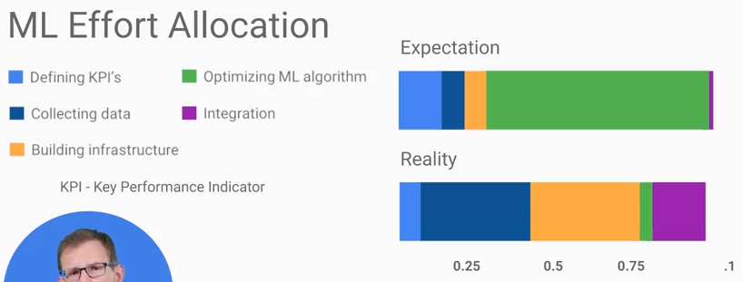
Learnings from Industry
Source: TensorFlow, Coursera https://www.coursera.org/learn/google-machine-learning/home/welcome

Slide 48
Learnings from Industry
One approach not sufficient
Solve using multiple ways and ensemble

Slide 49
Surviving ML Onslaught
Everyday what you do, make sure it generates new challenges frequently

Slide 50
Current Buzz – Top 5 Data Science GitHub Repositories
Flair (State-of-the-Art NLP Library)
Based on PyTorch
face.evoLVe – High Performance Face Recognition Library
High performance deep face recognition
YOLOv3
Object detection tasks
FaceBoxes: A CPU Real-Time Face Detector with High Accuracy
Face detecting approach, No GPU
Transformer-XL from Google AI
Google AI team, NLP

Slide 51
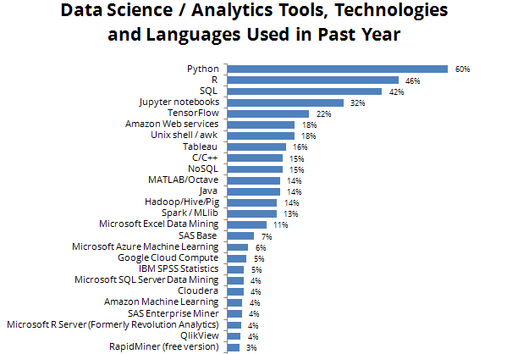
Current Buzz – Technologies being used

Slide 52
Learn Data Science
Coursera
Data Science Specialization – John Hopkins
https://www.coursera.org/specializations/jhu-data-science
Deep Learning Specialization – Andrew Ng
https://www.coursera.org/specializations/deep-learning
Machine Learning Primer – Stanford
https://www.coursera.org/learn/machine-learning
Analytics Vidhya
https://www.analyticsvidhya.com
Medium.com
Data Science specific stream
https://towardsdatascience.com/

Slide 53
Recap
Why to discuss Data Science?
What is Data Science?
The Fourth Paradigm
Four V’s of Data
Data Science Umbrella, Technologies, Lifecycle
How Machines Learn, AI, ML, DL?
Machine Learning – Intro
Applications of Data Science, ML
Learnings from Industry
Learn Data Science

Slide 54
Thank You!

